Slide 1
Improving Deep Neural Networks
Deep Learning Specialization Report
Toshiba Software Development (Vietnam) Co., Ltd.
2021-10-05

Slide 2
Contents
01
Practical Aspects of Deep Learning
02
Optimization Algorithms
03
Hyperparameter Tuning, Batch Normalization and Programming Frameworks
04
Questions

Slide 3
Practical Aspects of Deep Learning
01

Slide 4
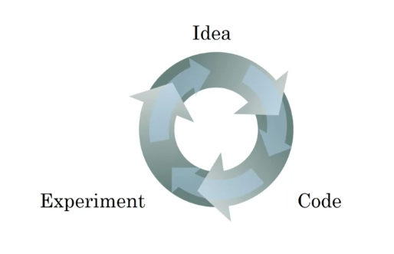
Setting up Machine Learning Application (1)
Applied Machine Learning (ML) is a highly iterative process.
Splitting into train, dev & test sets:
Training sets: to build model.
Dev sets (validation sets): to optimize hyperparameters
Test sets: try & evaluate.
Notes:
Dev & test set from same distribution.
Notes:
+ Quá trình: start idea (identify problems, proposal algorithms, design 1 nn) -> implement -> run & experiment get a result tell how well this particular networks or config. Try to find better neural network for application.
+ (?) làm sao để quá trình trên trở lên hiệu quả.
solve: setting dataset can make u more efficient.
+ same distribution:

Slide 5
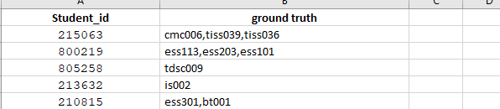
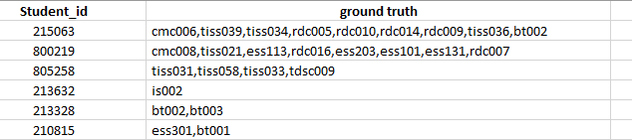
How to Extract the new 150-test samples
From 150 samples test set, we find that only 137 samples were annotated. We use them as the test set, to evaluate performance of the system whose word2vec models and parameters are optimized with the validation set.
Two possible test sets can be defined as
The samples to which the recommended jobs are labeled with at least one “Yes”.
The samples to which the recommended jobs are labeled with at least one “Yes” or one “Maybe”.
Test set 1
Test set 2
Test set 1 has 106 samples, while test set 2 has 127 samples.
The number jobs which are confirmed OK by IRD in test set 1 < in Test set 2, because constraint used for selecting OK jobs in the test set 2 is looser than the test set 1.
Till now, we only use test set 1 for evaluation

Slide 6
Introduction to Deep Learning
Types:
Standard Neural Network
Convolutional Neural Network
Recurrent Neural Network
Hybrid/ Custom Neural Network
Why is deep learning taking off?
Data: the amount of data is increasing,…
Computation: GPU,…
Algorithms: optimization algorithms, activation functions,…

Slide 7
Logistic Regression as a Neural Network
02

Slide 8
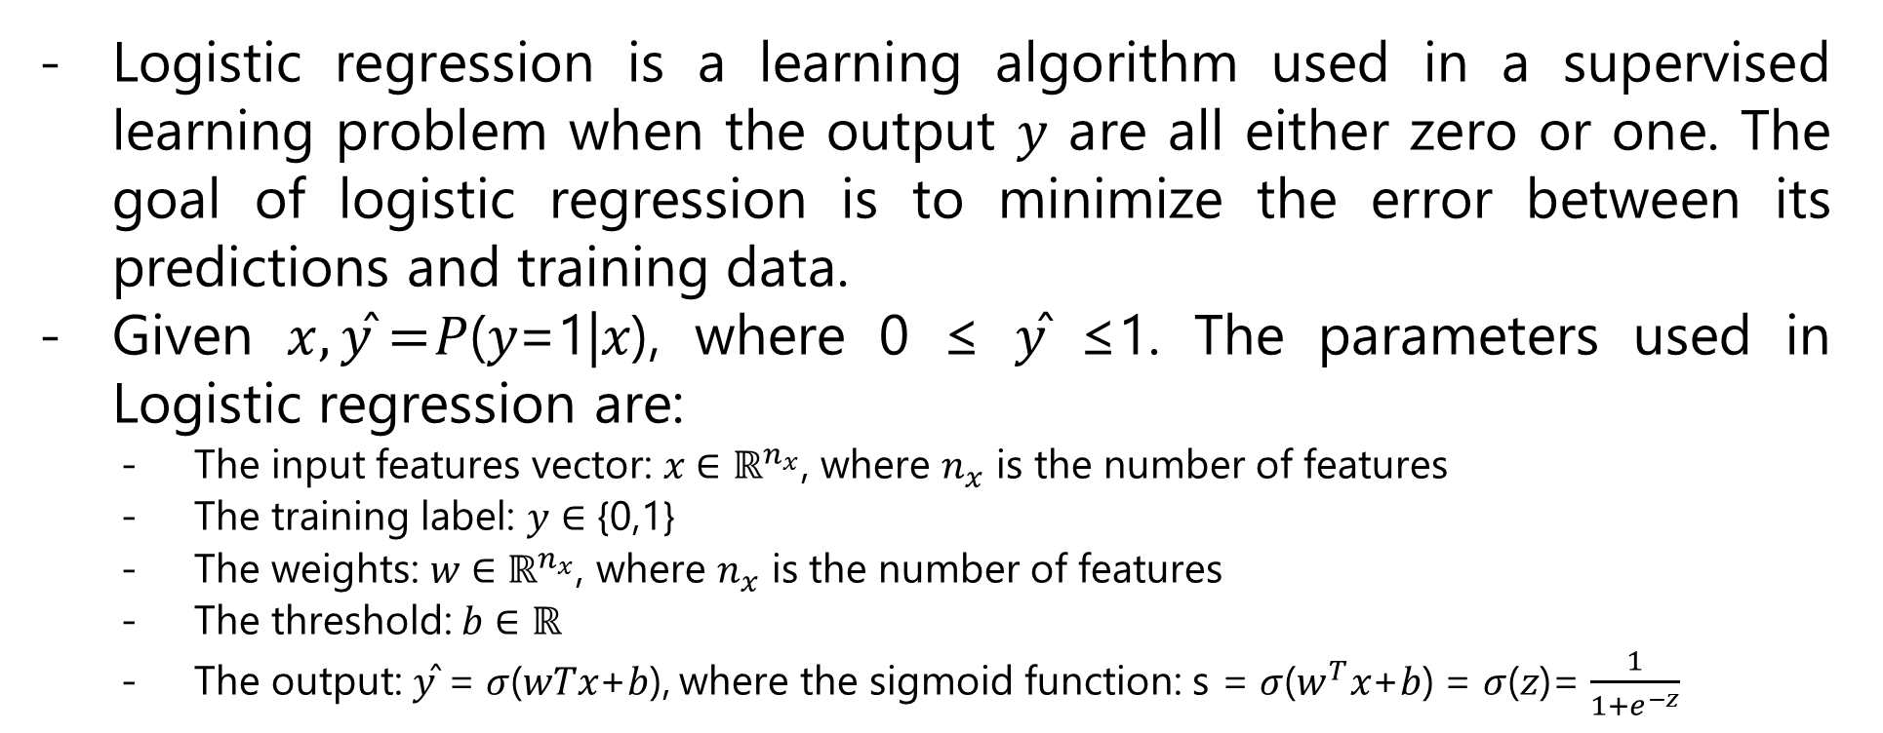
Logistic Regression as a Neural Network
Logistic regression is a learning algorithm used in a supervised learning problem when the output 𝑦 are all either zero or one. The goal of logistic regression is to minimize the error between its predictions and training data.
Given $x,\text{y}\text{̂}=$𝑃(𝑦=1|𝑥), where 0 ≤ 𝑦̂ ≤1. The parameters used in Logistic regression are:
The input features vector: 𝑥 ∈ ${\text{ℝ}}^{n_{x}}$, where $n_{x}$ is the number of features
The training label: 𝑦 ∈ {0,1}
The weights: 𝑤 ∈ ${\text{ℝ}}^{n_{x}}$, where $n_{x}$ is the number of features
The threshold: 𝑏 ∈ ℝ
The output: 𝑦̂ = 𝜎(𝑤𝑇𝑥+𝑏), where the sigmoid function: s = 𝜎($w^{T}$𝑥+𝑏) = 𝜎(𝑧)= $\frac{1}{1+e^{−z}}$

Slide 9
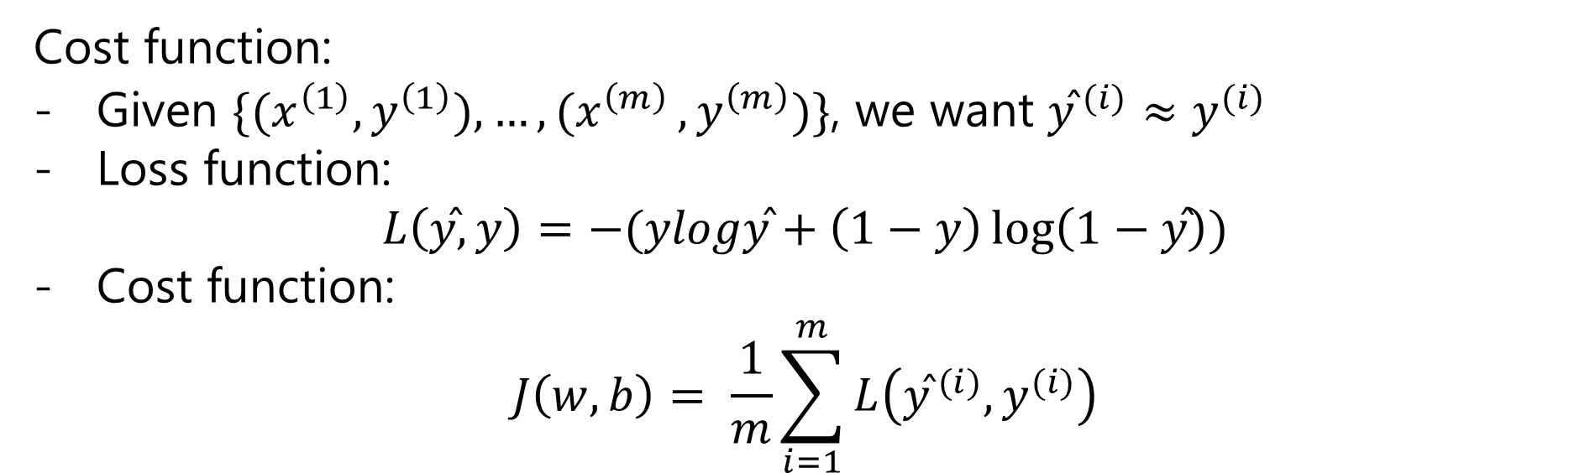
Logistic Regression as a Neural Network
Cost function:
Given $\{{(x}^{\left(1\right)},y^{\left(1\right)}),{…,(x}^{\left(m\right)},y^{\left(m\right)})\}$, we want ${\text{y}\text{̂}}^{ (i)}≈y^{(i)}$
Loss function:
$$L\left(\text{y}\text{̂}, y\right)=−(ylog\text{y}\text{̂}+\left(1−y\right)\log\left(1−\text{y}\text{̂}\right))$$
Cost function:
$$J\left(w, b\right)= \frac{1}{m}\sum_{i=1}^{m}{L\left({\text{y}\text{̂}}^{ (i)},y^{(i)}\right)}$$

Slide 10
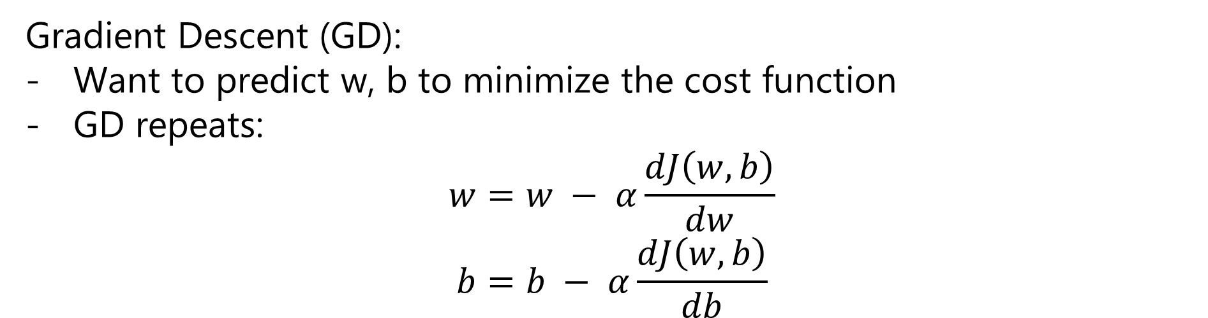
Logistic Regression as a Neural Network
Gradient Descent (GD):
Want to predict w, b to minimize the cost function
GD repeats:
$$w=w − α\frac{dJ\left(w, b\right)}{dw}$$
$$b=b − α\frac{dJ\left(w, b\right)}{db}$$

Slide 11
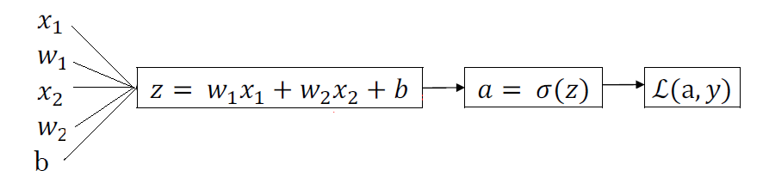

Logistic Regression as a Neural Network
Computation graph for computing derivatives:
$$da= \frac{−y}{a}+\frac{1−y}{1−a}$$
$$dz=a\left(1−a\right)$$
$$dw_{1}=x_{1}dz$$
$$dw_{2}=x_{2}dz$$
$$db=dz$$

Slide 12
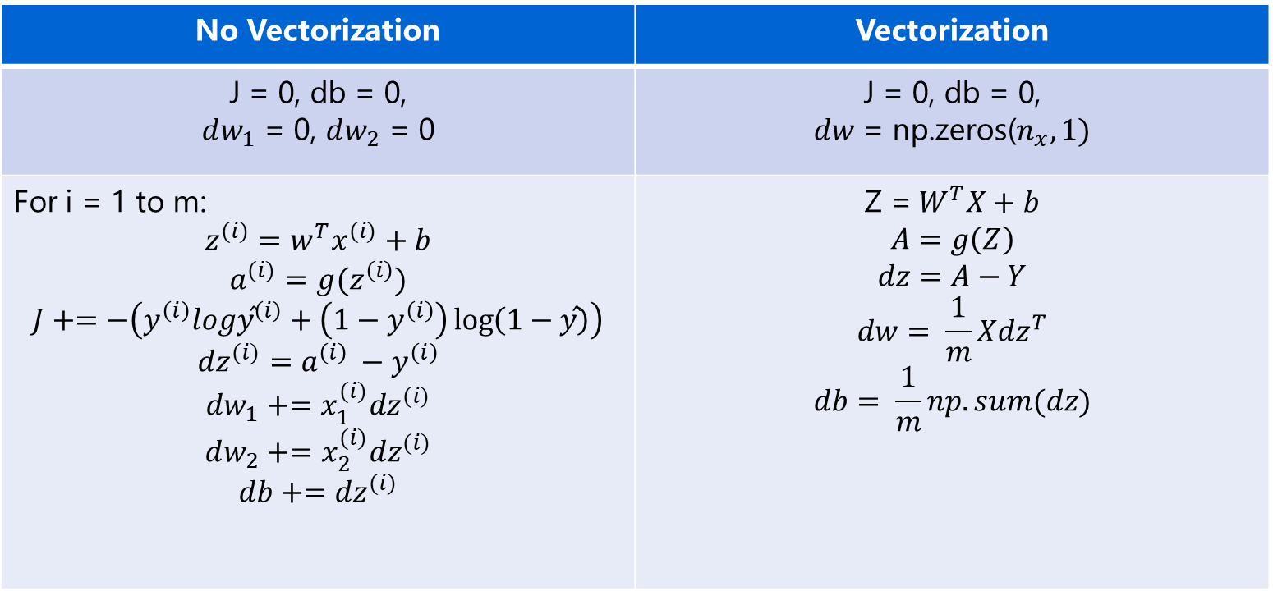
Logistic Regression as a Neural Network
Gradient Descent for m examples:
No Vectorization | Vectorization
J = 0, db = 0, $dw_{1}$ = 0, $dw_{2}$ = 0 | J = 0, db = 0, $dw$ = np.zeros($n_{x}, 1)$
For i = 1 to m: $$z^{(i)}=w^{T}x^{(i)}+b$$ $$a^{(i)}=g(z^{\left(i\right)})$$ $$J+=−\left(y^{\left(i\right)}log{\text{y}\text{̂}}^{\left(i\right)}+\left(1−y^{\left(i\right)}\right)\log\left(1−\text{y}\text{̂}\right)\right)$$ $${dz}^{(i)}=a^{\left(i\right)} −y^{\left(i\right)}$$ $$dw_{1}+={x_{1}^{(i)}dz}^{(i)}$$ $$dw_{2}+={x_{2}^{(i)}dz}^{(i)}$$ $$db+={dz}^{(i)}$$ | $$\text{Z}\text{ =} W^{T}X+b$$ $$A=g\left(Z\right)$$ $$dz=A−Y$$ $$dw= \frac{1}{m}X{dz}^{T}$$ $$db= \frac{1}{m}np.sum(dz)$$

Slide 13
Shallow Neural Network
03

Slide 14
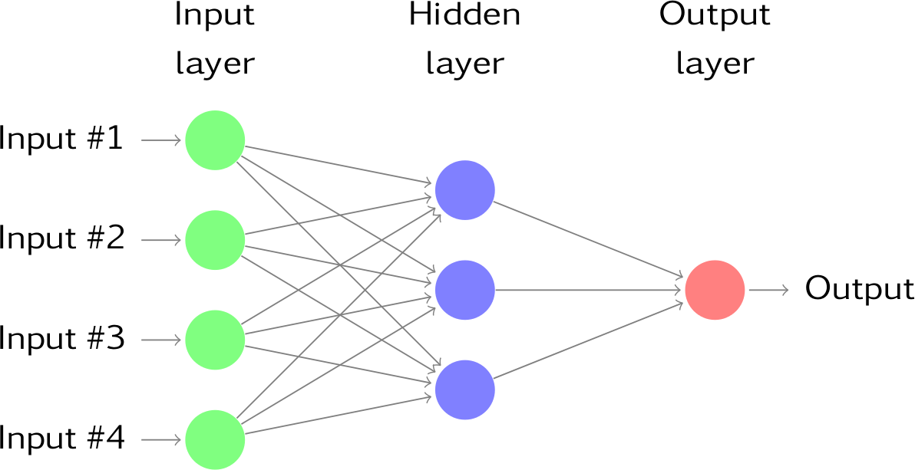
Shallow Neural Network
2-layer Neural Network

Slide 15
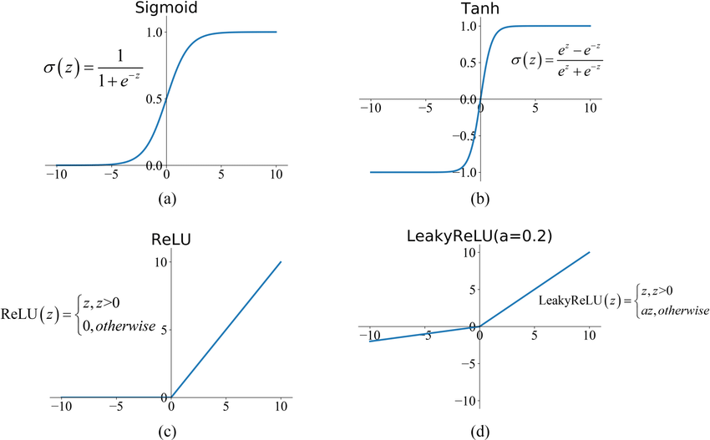
Shallow Neural Network
Activation function:

Slide 16
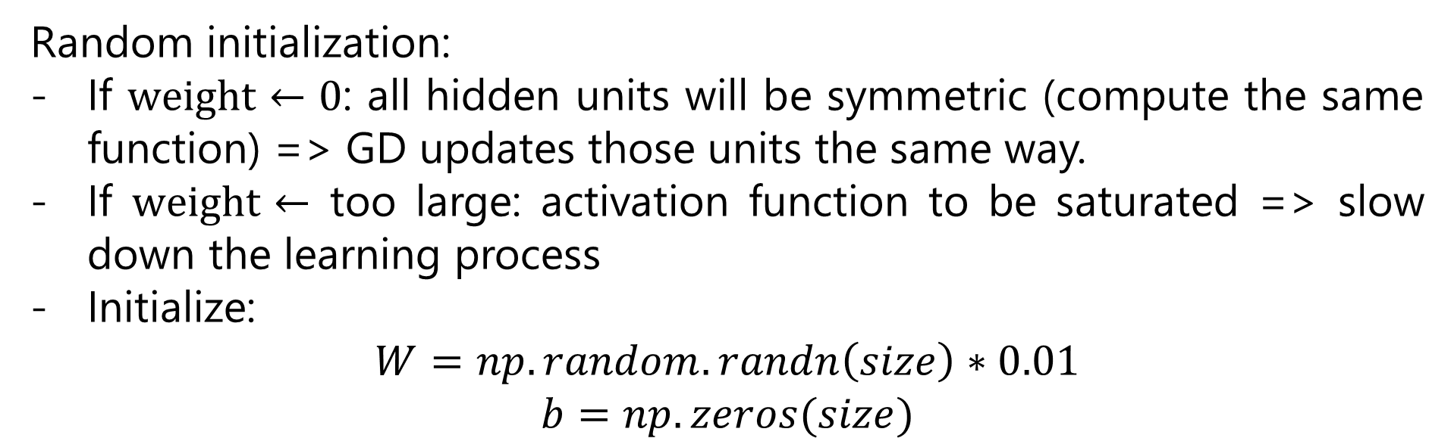
Shallow Neural Network
Random initialization:
If $weight←0$: all hidden units will be symmetric (compute the same function) => GD updates those units the same way.
If $weight←$ too large: activation function to be saturated => slow down the learning process
Initialize:
$$W=np.random.randn\left(size\right)∗0.01$$
$$b=np.zeros(size)$$

Slide 17
Deep Neural Network
04

Slide 18
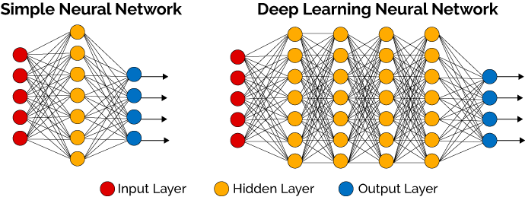
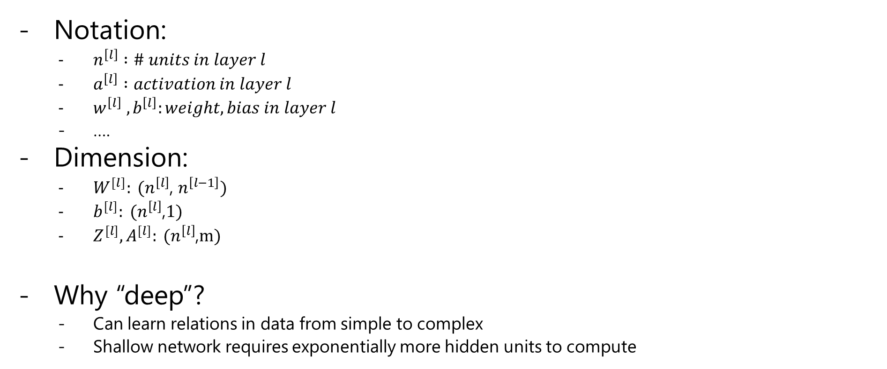
Deep Neural Network
Notation:
$n^{\left[l\right]} :\# units in layer l$
$a^{\left[l\right]} :activation in layer l$
$w^{\left[l\right]} ,b^{\left[l\right]}:weight, bias in layer l$
….
Dimension:
$W^{[l]}: (n^{\left[l\right]}$, $n^{\left[l−1\right]})$
$b^{[l]}: (n^{\left[l\right]}$,$1)$
$Z^{[l]}, A^{[l]}: (n^{\left[l\right]}$,$m)$
Why “deep”?
Can learn relations in data from simple to complex
Shallow network requires exponentially more hidden units to compute

Slide 19
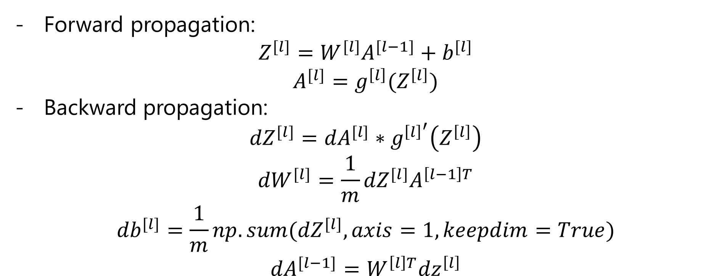
Deep Neural Network
Forward propagation:
$$Z^{[l]}=W^{[l]}A^{[l−1]}+b^{[l]}$$
$$A^{[l]}=g^{\left[l\right]}(Z^{\left[l\right]})$$
Backward propagation:
$${dZ}^{[l]}={dA}^{[l]}∗g^{{\left[l\right]}^{′}}\left(Z^{\left[l\right]}\right)$$
$${dW}^{[l]}=\frac{1}{m}{dZ}^{[l]}A^{\left[l−1\right]T}$$
$${db}^{[l]}=\frac{1}{m}{np.sum(dZ}^{[l]}, axis=1, keepdim=True)$$
$${dA}^{[l−1]}=W^{\left[l\right]T}{dz}^{\left[l\right]}$$

Slide 20
Thank you

